Slide 1
Perseverance, Persistence, and Potatoes
The Life and Legacy of George Shima
Materials created by Owen Flannery, February 22, 2025
This work is licensed under CC BY-NC-SA 4.0. To view a copy of this license, visit https://creativecommons.org/licenses/by-nc-sa/4.0/
Notes:
Sources: https://www.nps.gov/articles/ssjd-potato-king.htm
https://www.centraloregonian.com/news/central-oregon-history-george-shima-becomes-first-japanese-american-millionaire/article_e5918a05-6ba6-51f9-97b8-e52b07a6c0d6.html

Slide 2
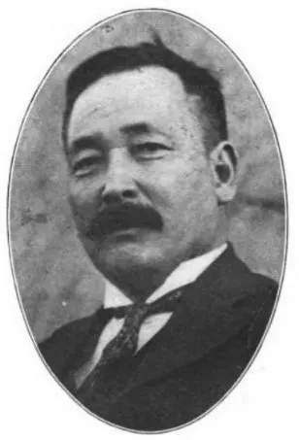
George Shima (Ushijima Kinji)
Born in Japan in 1864
Failed the English language portion of his university entrance exams
Moved to the United States in 1889 and changed his name upon arrival.

Slide 3
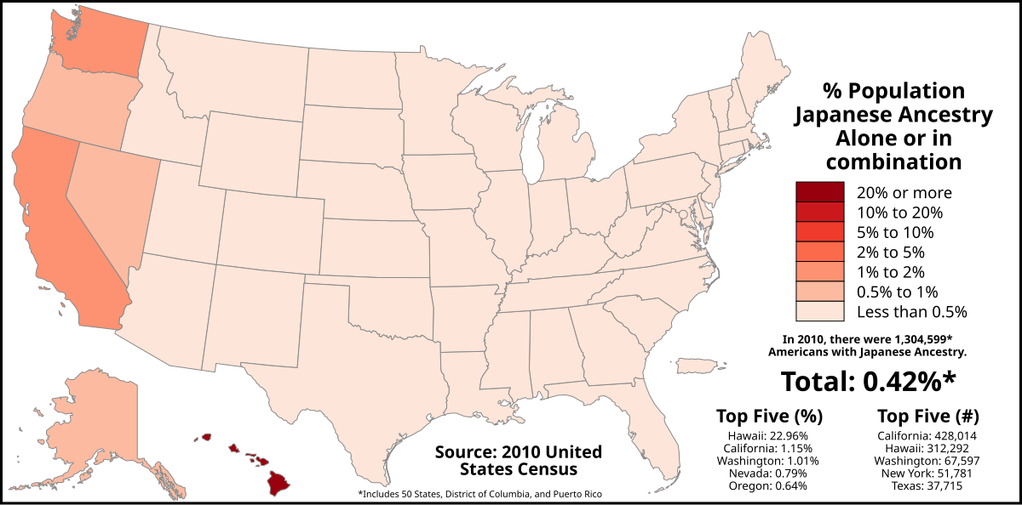
Why might Shima and other immigrants have changed their names upon moving to the United States?
What impact might that have on someone’s cultural identity and values?

Slide 4
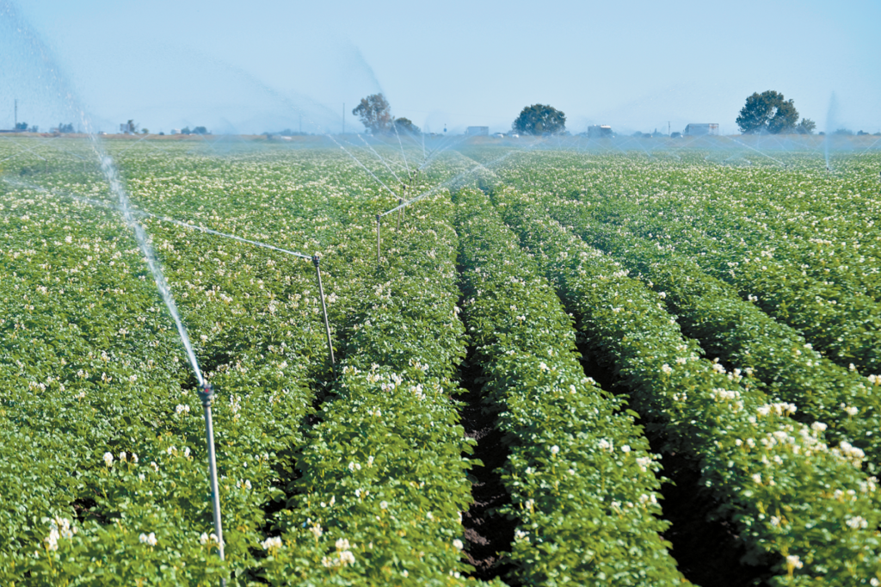
The “Potato King”
Shima worked as a farm laborer on land in the Sacramento River Delta, where he developed a reputation for being hard working.
Shima saved enough money to buy some cheap farm land, even though the land was deemed “inappropriate for farming”

Slide 5
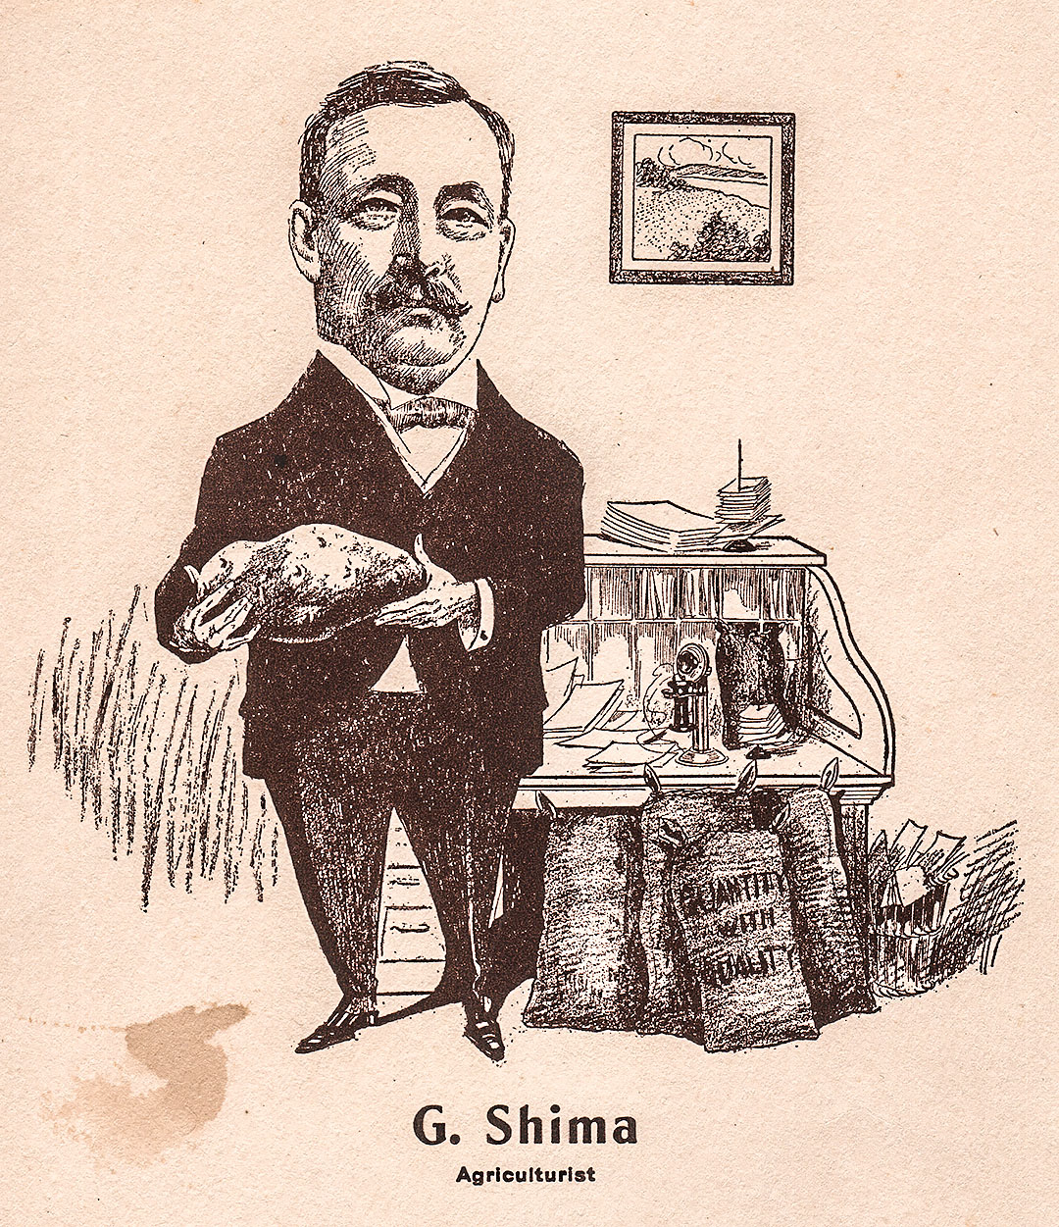
The “Potato King”
George Shima attempted to grow beans and rice but failed.
He then made an attempt at growing potatoes and found a great deal of success.
Shima’s irrigation and water management systems were the key to his success.
By 1909, Shima’s farms produced more potatoes than any other farm in the world.
This eventually led to Shima becoming the first Japanese-American millionaire.

Slide 6
Facing Resistance
Looking to expand his Potato Empire, Shima purchased land in Central Oregon in 1919.
White farmers in Central Oregon feared that Shima would bring in Japanese and Chinese laborers into the area, echoing the national sentiment of fear towards Asian immigrants.
Why might these white farmers be fearful of other groups, especially given Shima’s successful reputation?

Slide 7
Exit Ticket - Written Response
How did George Shima’s background influence his success as a farmer?
List 2-3 examples of resilience that allowed George Shima to become successful. Be sure to include both the losses (what was the problem he faced), as well as the wins (how did he overcome his failures)?
What might Shima’s story teach us about overcoming challenges in our own lives? Are there any groups today that may be facing similar challenges?

